Slide 1


Recently, the pro-terrorist campaign of “AAA–Ads Against Apartheid” shocked the
Boston Subway passengers

Slide 2

Claiming that Israel is
destroying Palestinian homes

Slide 3
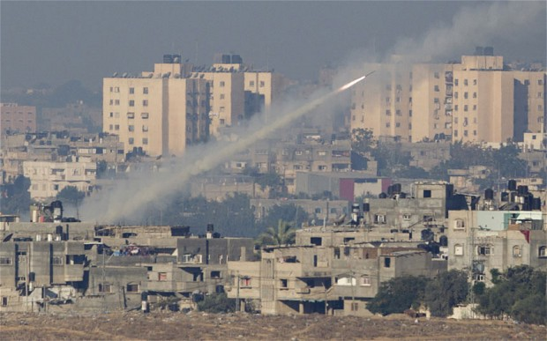
When you are launching rockets from your homes in order to destroy Israeli homes,
don’t be surprised if you will remain HOMELESS

Slide 4
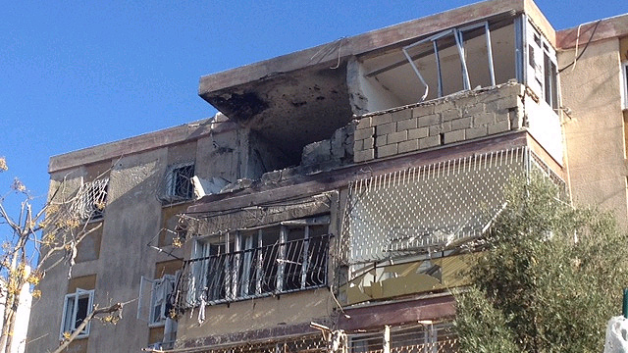
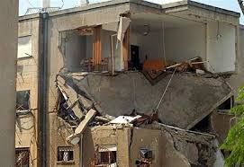
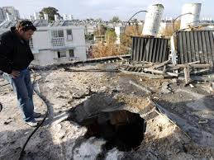
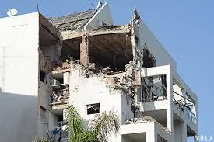
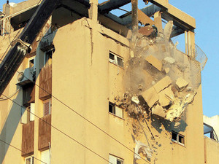
Israel defend itself selectively as the Palestinian bombarding Israeli civilian homes indiscriminately
Israel has the right to defend itself

Slide 5


Oh, and you Bostonians
should know this better than others

